Slide 1
Cybersecurity
Trojans and RATs

Slide 2

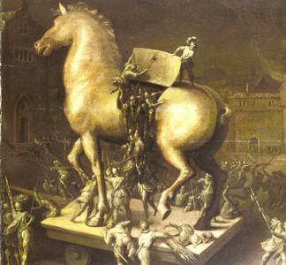
Trojan Horse
Software that hides malicious code inside
Used to attack computer
Does not self-replicate
Circumvents existing security
Anti-virus may or may not catch it
Really nasty Trojans even disable anti-virus!
Once in machine, free to attack
May open doors for other programs

Slide 3

Backdoor
Avoids normal login processes
Leave a backdoor open
Often installed through malware
Some malware exploit backdoors created by other malware!
Some programs have accidental backdoors
Old version of Linux kernel included a backdoor
Malicious software can have a backdoor as part of the app
Pretends to be a free game, actually malware in disguise
Pirated software may be modified to provide backdoor
“Free” can be an enticing lure to unsuspecting.

Slide 4
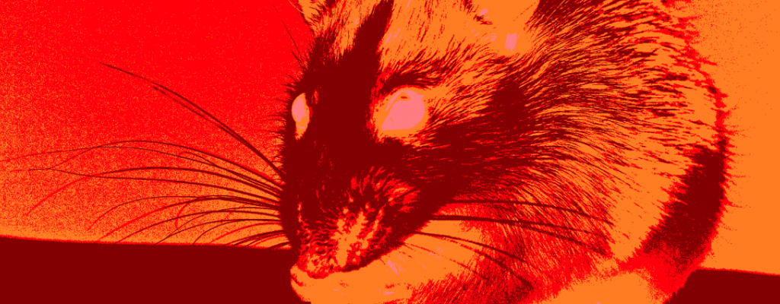
Remote Access Trojans (RATs)
Remote Administration Tool
Ultimate Backdoor
Administrative control of host
Malware installs the server, service, or host
Allows hackers to connect via remote software
Controls device
Log keystrokes
Take screenshots
Control webcam
Copy files
Embed other malware

Slide 5
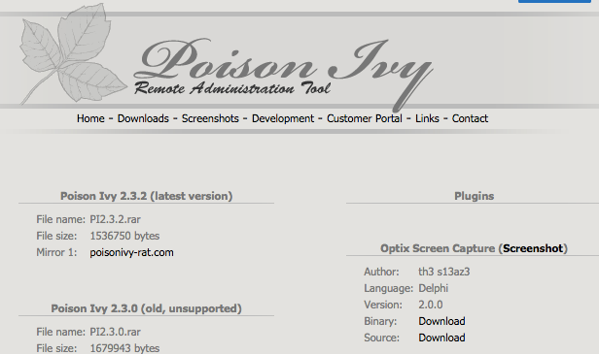
PoisonIvy RAT

Slide 6
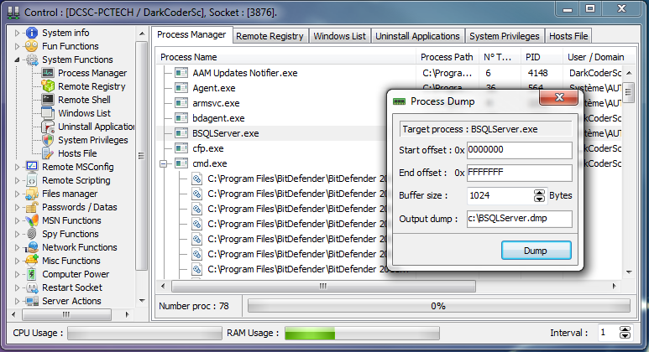
DarkComet RAT

Slide 7
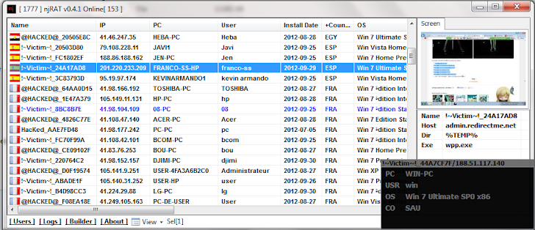
njRAT

Slide 8

Protecting Against Trojans and RATs
Do not run unknown or untrusted software
Keep anti-virus/anti-malware updated
New attacks happen all the time
Keep system backups
Ideally offline

